Slide 1
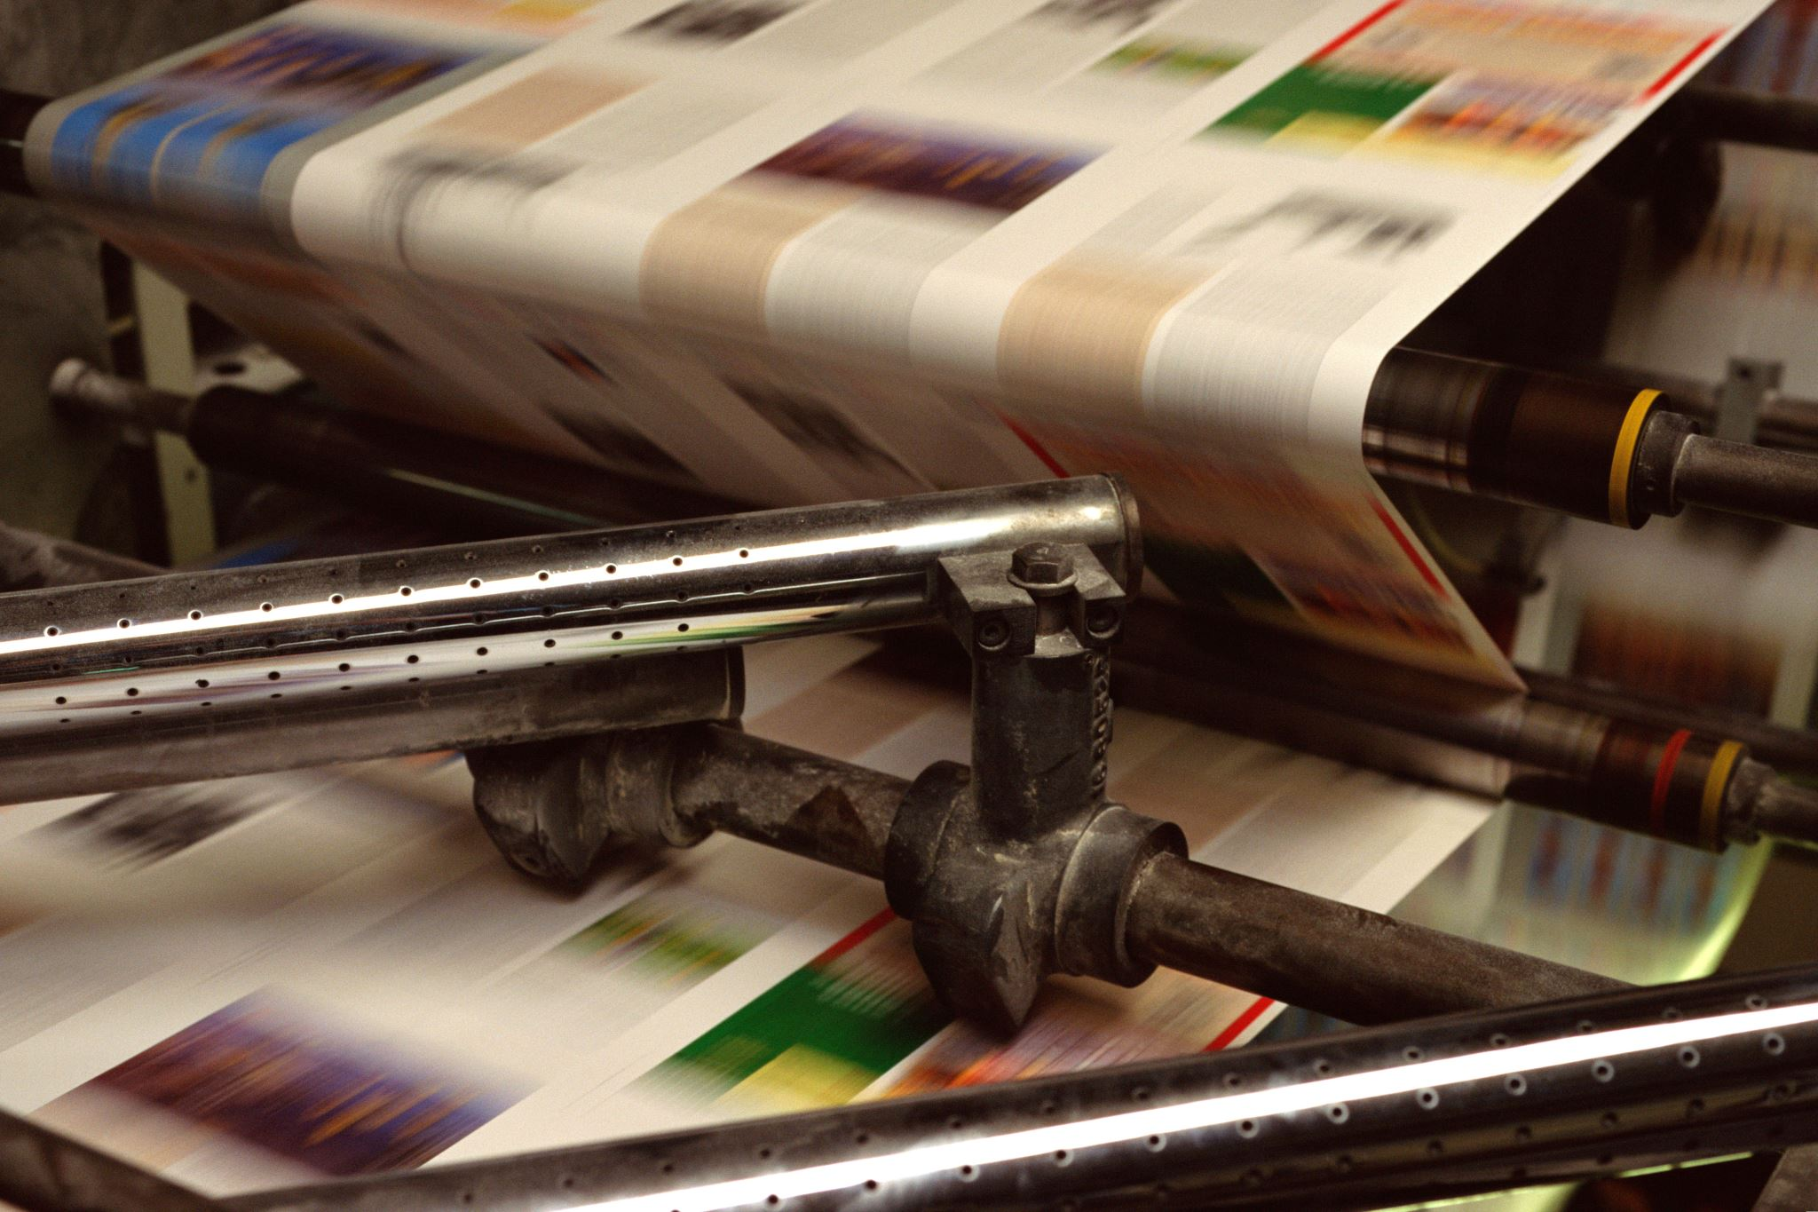
Automated Generation of Soviet Propaganda-Themed Artworks: An Exploration Using Generative adversarial networks
by Karen Nurlybekov

Slide 2

Survey Methodology
- Target demographic for the survey included individuals from ex-Soviet countries and non-communistic nations to diversify respondents.
- Qualitative evaluation was implemented through public surveys to assess the stylistic fidelity to Soviet propaganda posters.
- Survey questions included rating images on a scale of 0-10 for resemblance to Soviet propaganda, demographic inquiries, and classification assessments.

Slide 3

Demographic Data
- The demographic data collected encompassed gender, age, occupation, and origin details of the survey participants.
- Visual representations such as graphs were utilized to depict the distribution of respondents based on gender, age, occupation, and origin.
- Graphical representations aided in illustrating the diversity within the survey population and provided insights into the varied demographics of the participants.

Slide 4
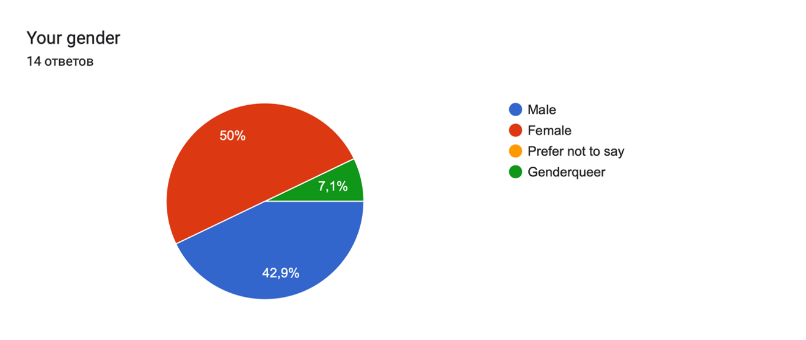

Slide 5
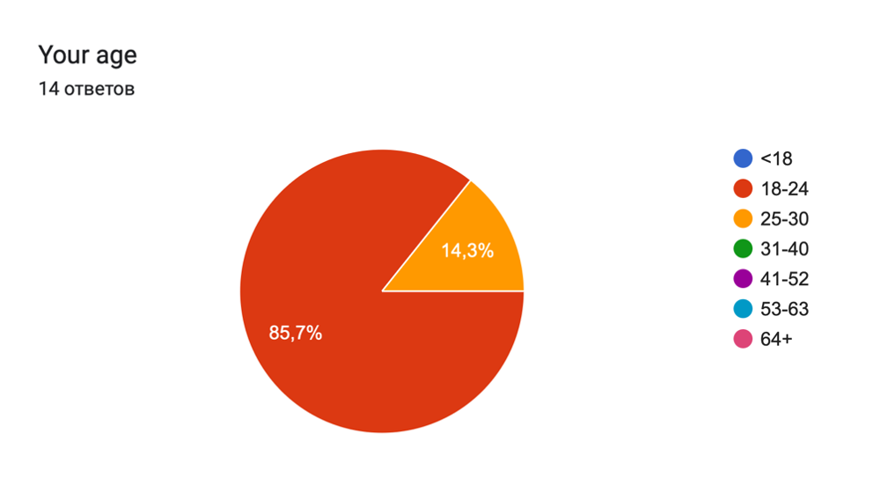

Slide 6
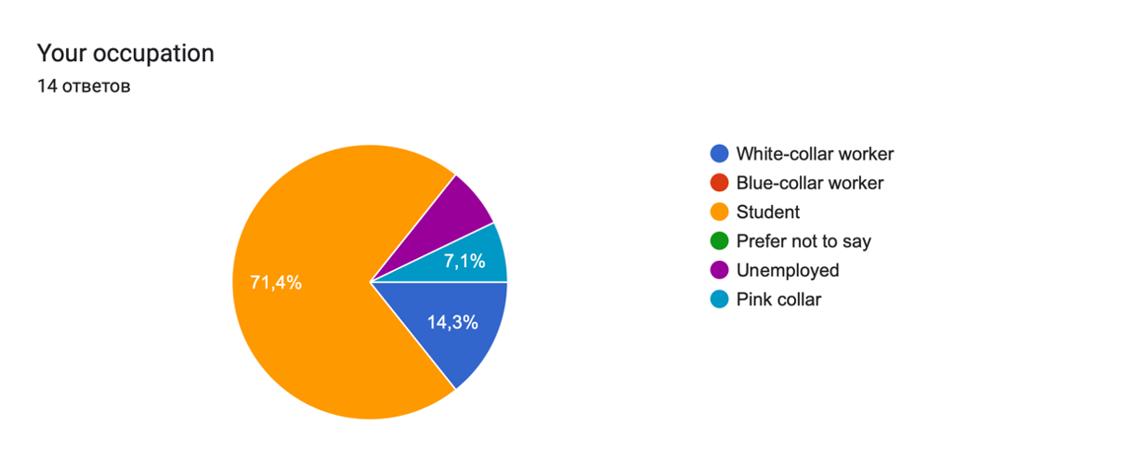

Slide 7
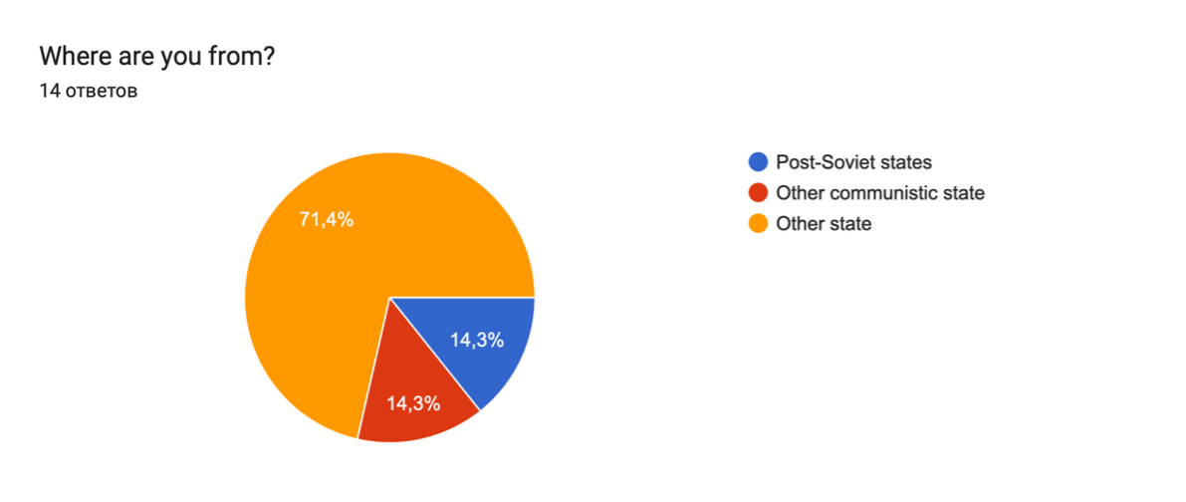

Slide 8
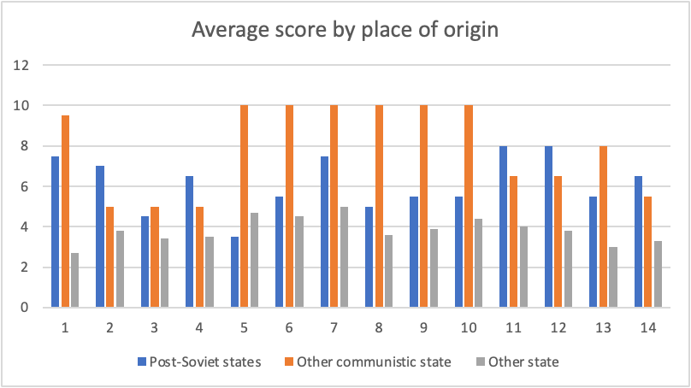

Slide 9
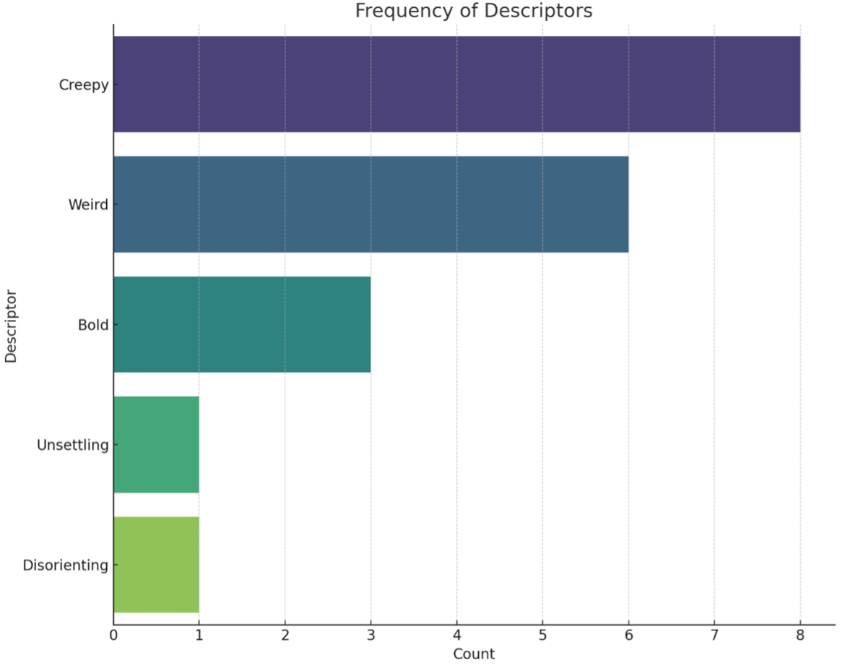

Slide 10
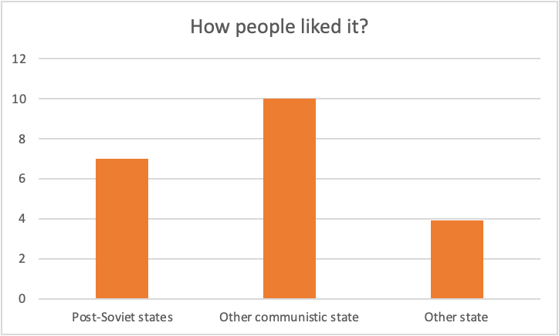

Slide 11
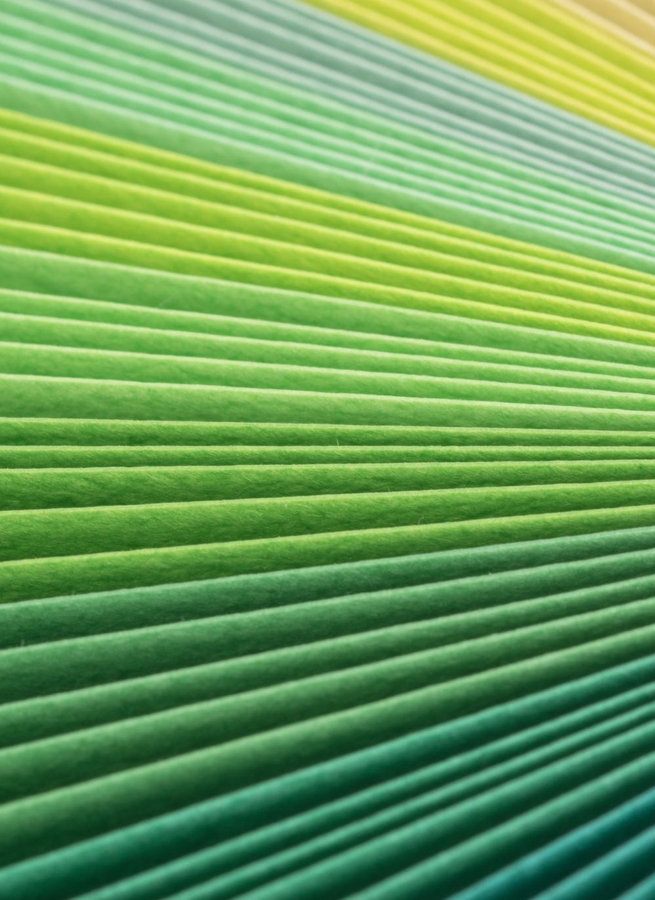
Main Findings
- People from other states did not liked the images.
- People find images more creepy and weird rather than bold.
- Enough respondents stated that images might be a soviet propaganda posters.

Slide 12
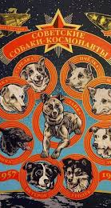
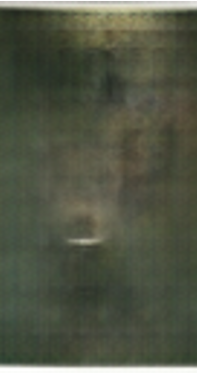
Chernushka (PROPAGANDA) #1
Shown picture shows one of the famous dogs-astronauts which returned from space alive. Shown artwork express dog in the dark space. The portrayal of Chernushka against a backdrop that suggests the vast, dark expanse of space adds a layer of profundity to the piece, highlighting the isolation and perhaps the uncertainty faced by these animals on their extraordinary journeys.

Slide 13
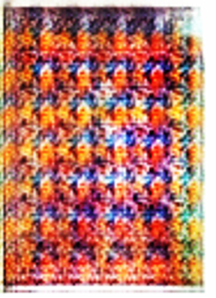
Raisa Pavlovna Diptych (PROPAGANDA) #10
It is a representation and praise of the soviet feminism – average proletarian woman accountant from late-Brezhnev time presented in a style of famous Marilyn Diptych by Andy Warhol. Each repetition of the image, while identical in form, is rendered with a diverse color palette, creating a tapestry that echoes the uniformity yet individuality of the Soviet working woman.

Slide 14
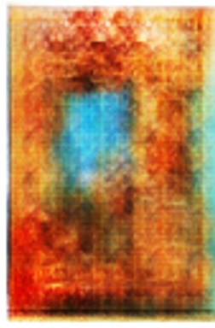
Nuclear abstraction #3
Abstract image of the nuclear fire in a sky. The way blend fiery oranges, reds, and yellows colors merge and dance across the canvas gives a sense of movement and chaos, possibly reflecting the uncontrollable and destructive nature of nuclear forces.

Slide 15
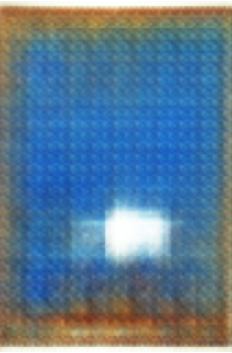
Sarmat (PROPAGANDA) #12
RS-28 Sarmat ballistic missile transcends the speed of sound, a metaphor for breaking barriers and the sheer force of technological advancement. Also been reported by some respondents as the bombing of Belgrade

Slide 16
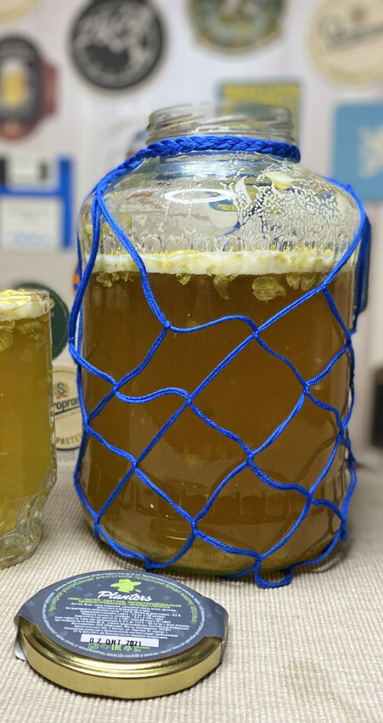
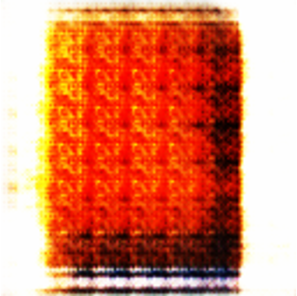
Zhigulevskoe, 3-liters, abstraction #6
Abstraction on the most favorite drinks of soviet proletaries – light beer in 3-liter jar. The warm tones ranging from deep amber to golden hues are reminiscent of the color of beer, capturing the essence of the beverage and its cultural significance.

Slide 17
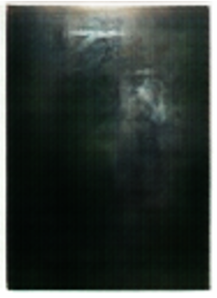
#2

Slide 18
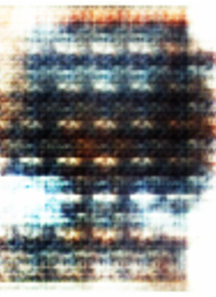
#7

Slide 19
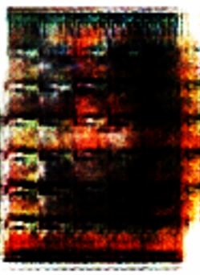
#5

Slide 20
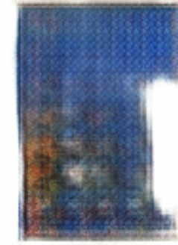
#8

Slide 21
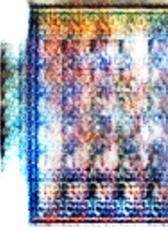
#9

Slide 22
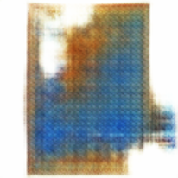
#13

Slide 23
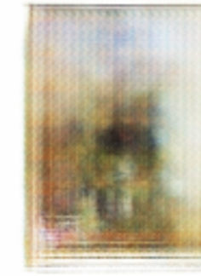
#11

Slide 24
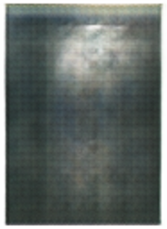
#4

Slide 25
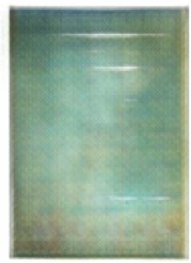
#14

Slide 26

Pseudocode Overview
Import
- Import necessary libraries including TensorFlow, time, glob, and os for the TensorFlow adaptation with Keras for high-level neural networks API.
Define
- Define global configurations such as image_folder, batch_size, img_height, and img_width to set up the initial parameters for the image preprocessing and model training.
Implement
- Implement functions for loading and preprocessing images, creating the generator and discriminator models, defining loss functions, optimizers, and setting up the main training loop for the GAN model.

Slide 27

Limitations and Challenges
- The limitations and challenges encountered during the project included hardware constraints impacting the power of the laptop and the use of the Adam optimizer on ARM-based processors.
- The optimization issues with the Adam optimizer led to a compromise in the image quality and training duration, requiring adjustments to the size of generated images and training data.
- The training process was prolonged due to hardware limitations, affecting the goal of mimicking the Soviet propaganda poster style and resulting in images that were deemed readable but not optimal.

Slide 28

Next Steps and Future Directions
- Implement Conditional GANs for more control over image characteristics, enhancing the precision of stylistic elements in the generated Soviet propaganda posters.
- Utilize cloud computing services to optimize training efficiency, overcoming hardware limitations and enhancing the scalability of image generation processes.
- Envision advancements in image generation techniques by combining Conditional GANs with cloud computing for a significant leap forward in authenticity and resonance of the generated posters.

Slide 29
Bibliography
- SovietPosters: Utilized as a key resource for accessing Soviet propaganda posters to build the dataset for training the Generative Adversarial Networks (GANs).
- Research Paper by Z. Shi et al.: Referenced for insights into various GAN techniques and their effects on high-quality image generation processes.
- Algoscale Technologies Inc.: Used as a source for understanding the practical application of GANs in generating images with advanced AI technologies.

